Slide 1
SQL Transaction: Group 1
By Nikhil, Amoye, Fariya

Slide 2
Overview
ERD for Product/Stock/Depot Schema
Code Demo

Slide 3
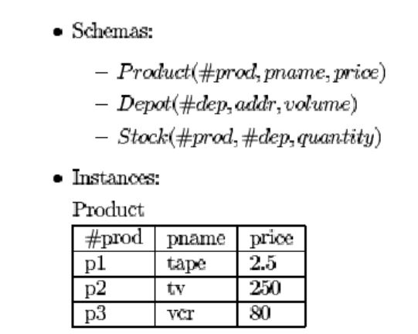
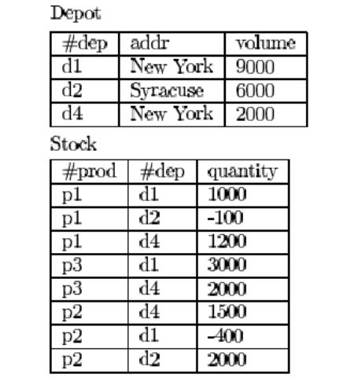
Original Schema & Instances

Slide 4
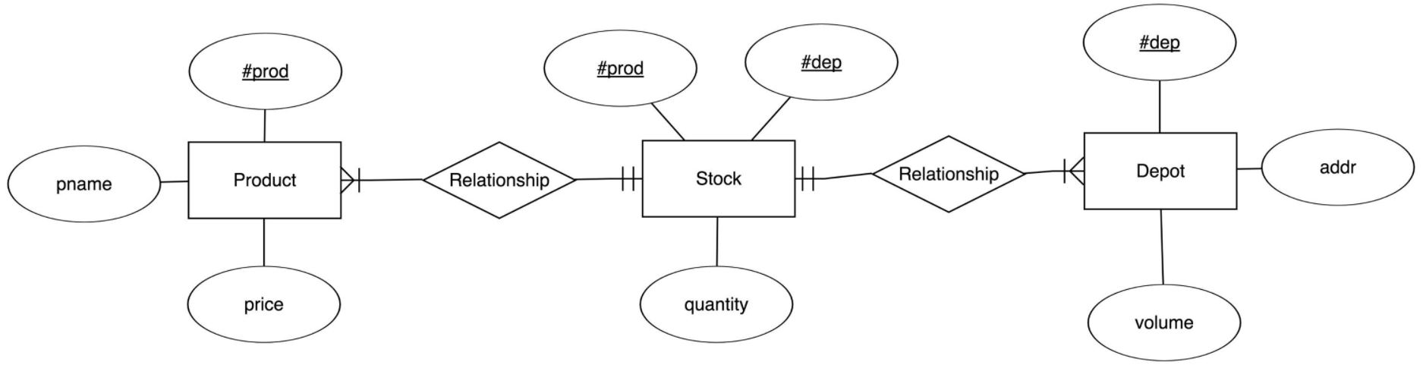
ERD

Slide 5
ERD
PK
PK
Composite
Composite

Slide 6
ERD
n:1
1:n
1:1
1:1

Slide 7
DEMO
Transaction: The product p1 is deleted from product and stock.
Review of the transaction code
Transaction with implementation of ACID
Transaction with violation of ACID
LET’S VIEW THE DEMO OF THE CODE!

